Slide 1
5 Papers
Title | Publication source
Combining Deep Learning with Information Retrieval to Localize Buggy Files for Bug Reports (N) | ASE
Modeling bug report quality | ASE
Fault localization with nearest neighbor queries | ASE
Lightweight fault-localization using multiple coverage types | ICSE
The Probabilistic Program Dependence Graph and Its Application to Fault Diagnosis | TSE

Slide 2


Combining Deep Learning with Information Retrieval to Localize Buggy Files for Bug Reports (N)
汇报人：王昭丹

Slide 3

CONTENTS
01. INTRODUCTION
02. COMBINING MODEL —— HyLoc
03. DNN-BASED RELEVANCY ESTIMATION
04. EMPIRICAL EVALUATION

Slide 4
INTRODUCTION
statistics of program analysis information
content of a given bug report
semantics of the program and/or its execution information
with test cases
information retrieval (IR) / machine learning (ML)
extracting important features
from the given bug report and source files
Key Limitation
rVSM
lexical mismatch between natural language texts in bug reports and technical terms in source code
HyLoc
DNN

Slide 5
HyLoc —— Key Design Ideas
Bridge lexical gap
Feature combination
Dimension reduction
Using DNN to bridge the lexical gap.
Two DNNs
Using another DNN for feature combination.
Using another DNN to perform dimension reduction for feature vectors.
1
2
3
Three types of features
textual similarity feature computed from rVSM
relevancy feature from the DNNs
metadata features —— bug-fixing recency score for a file

Slide 6
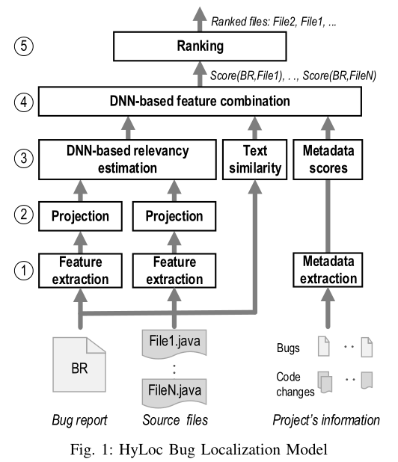
HyLoc Model Architecture
Bug report
Corresponding buggy file
Bug report
Similar non-buggy file
Train
positive pair
negative pair
Features
extraction
final score for
f1 to B
Feature
vectors
Prediction
source file f1
Features
extraction
Ranking
Feature
vectors
final score for
f2 to B
source file f2
Bug Report B
. . .
Features
extraction
Feature
vectors
final score for
fn to B
source file fn

Slide 7
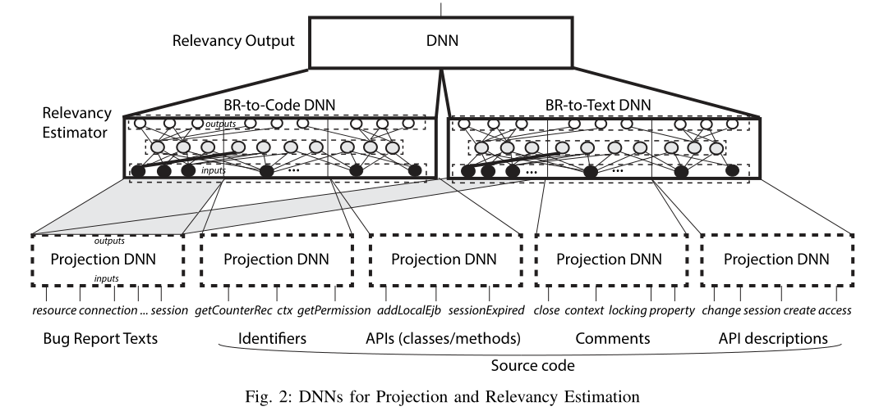
DNN-BASED RELEVANCY ESTIMATION
Two DNNs
Bug Report-to-Code DNN
learn the relations for the text features from bug reports and the source code features
Bug Report-to-Text DNN
learn the relations between the textual features in the bug reports and those in comments and API descriptions

Slide 8
EMPIRICAL EVALUATION
Experimental Setting
Three metrics for evaluation
Top-ranked accuracy
Mean Average Precision (MAP)
Mean inverse Rank (MRR)
Benchmark Dataset: provided by Ye et al.
For training: text similarity measure; top 300 similar files negative samples
For prediction: compute the scores and rank all the files in a project.
Sorted the bug reports chronologically by their report timestamps.
Divided the bug reports into 10 folds with equal sizes (fold1 - oldest and fold10 - newest).
Trained a model on foldi and tested it on foldi+1.

Slide 9
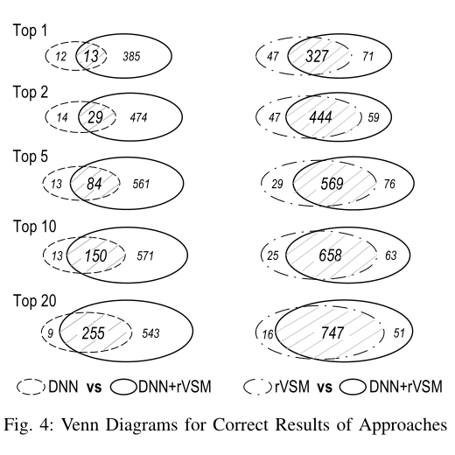
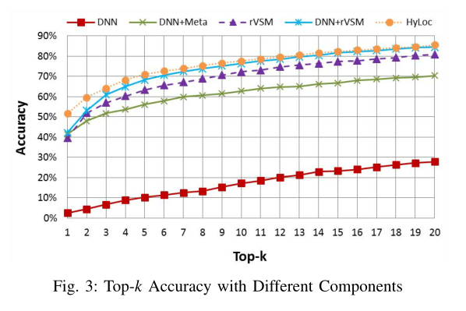
EMPIRICAL EVALUATION
Impacts of Components and Parameters on Accuracy
DNN, rVSM vs. DNN+rVSM Models
Accuracy with Different Components
DNN by itself does not give high accuracy
DNN+rVSM > both DNN and rVSM individually

Slide 10
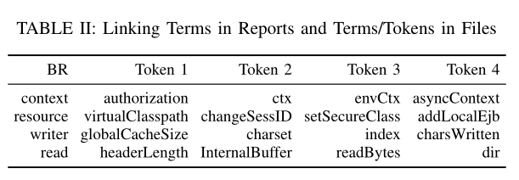
EMPIRICAL EVALUATION
b) Examples of Linking Terms in Two Spaces
c) Feature combination comparison
compare feature combination by DNN and by learn-to-rank approach
built another experimental model —— LRCombine
HyLoc higher than LRCombine 22% at top-1 accuracy, at top-5 is 10%
1. Each of the textual tokens in all bug reports as the input.
2. Paired it with each of the code tokens in source files and the textual tokens in comments/documentations.
3. DNN to compute the score output for each of such pairs.
4. Produced the list of “relevant” tokens in source files ranked by the relevancy score between two tokens.
non-linear combination better linear one

Slide 11
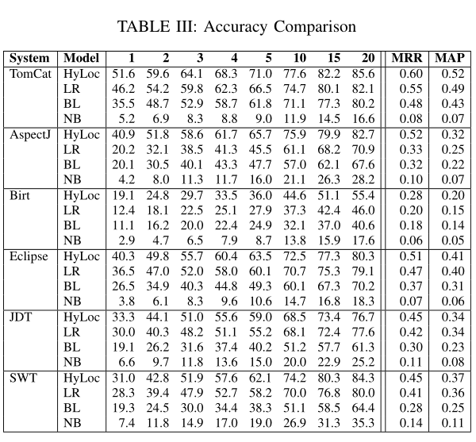
EMPIRICAL EVALUATION
Accuracy Comparison
Compare HyLoc to the stateof-the-art approaches:
Naive Bayes (NB) approach —— ML
LR (learn-to-rank) approach —— hybrid
BugLocator —— IR-based

Slide 12
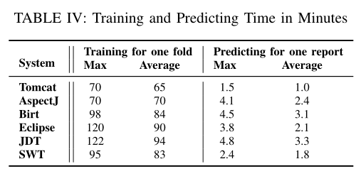
EMPIRICAL EVALUATION
Time Efficiency
Training time is large for a solution involving one thread to run DNN.
Parallel computing infrastructures for DNNs
Incremental training techniques
Predicting time is reasonable.

Slide 13
学习进展&暑期计划
感谢您的聆听
汇报人：王昭丹

